Slide 1
Automate a business process using Power Automate
Notes:
Link: https://docs.microsoft.com/en-us/learn/modules/flow-get-started/

Slide 2
What is Microsoft Dataverse?
Note
Effective November 2020:
Common Data Service has been renamed to Microsoft Dataverse. Learn more
Some terminology in Microsoft Dataverse has been updated. For example, entity is now table and field is now column. Learn more

Slide 3
Agenda
Get started with Power Automate
Build more complex flows with Power Automate
Introduction to business process flows with Power Automate
Create an immersive business process flow in Power Automate
Understand advanced business process flow concepts
Introduction to expression in Power Automate

Slide 4

Get started with Power Automate

Slide 5
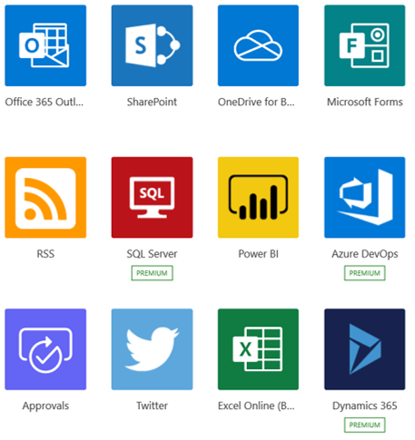
What is Power Automate?
Power Automate is an online workflow service that automates actions across the most common apps and services
Notes:
Power Automate is an online workflow service that automates actions across the most common apps and services. For example, you can create a flow that adds a lead to Microsoft Dynamics 365 and a record in MailChimp whenever someone with more than 100 followers tweets about your company.
When you sign up, you can connect to more than 220 services, and can manage data either in the cloud or in on-premises sources like SharePoint and Microsoft SQL Server. The list of applications you can use with Power Automate grows constantly.

Slide 6
What can you do with Power Automate?
Use Power Automate to automate workflows between your favorite applications and services, sync files, get notifications, collect data, and much more
For example, you can automate these tasks:
Instantly respond to high-priority notifications or emails
Capture, track, and follow up with new sales leads
Copy all email attachments to your OneDrive for Business account
Collect data about your business, and share that information with your team
Automate approval workflows
Notes:
You can use Power Automate to automate workflows between your favorite applications and services, sync files, get notifications, collect data, and much more.
For example, you can automate these tasks:
Instantly respond to high-priority notifications or emails.
Capture, track, and follow up with new sales leads.
Copy all email attachments to your OneDrive for Business account.
Collect data about your business, and share that information with your team.
Automate approval workflows.
A common use of Power Automate is to receive notifications. For example, you can instantly receive an email or a push notification on your phone whenever a sales lead is added to Dynamics 365 or Salesforce.

Slide 7
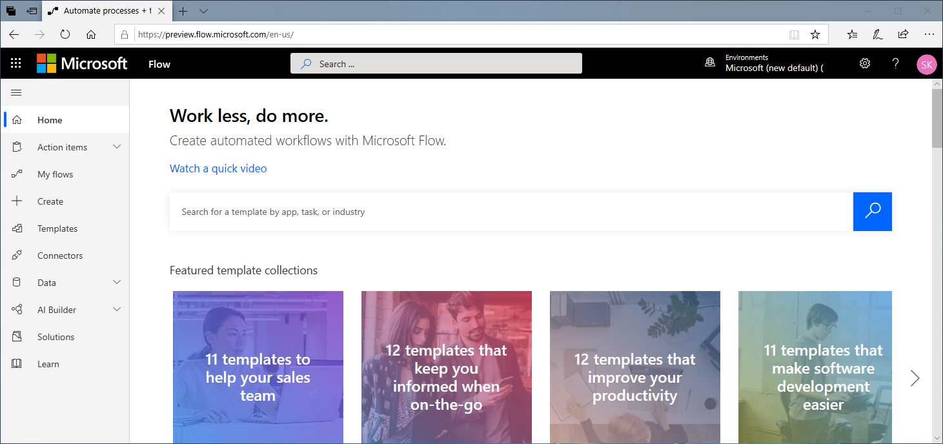
A brief tour of Power Automate
Flows can be created from: Make.powerapps.com
Notes:
Let's jump into Power Automate, and we'll show you around. We have tons of information for you to learn about how to use Power Automate.
When you sign in to Power Automate, you'll find these menus:
Action items, where you can manage approvals and business process flows.
My flows, where your flows reside.
Create, where you start a new flow.
Templates, where you can take a look at some of the most popular templates. These should give you some great ideas for flows you want to try.
Connectors, where you can connect from one service to another.
Data, where you can access entities, connections, custom connectors and gateways.
Solutions, where you can manage your solutions.
Learn, where you can find information that will help you quickly ramp up on Power Automate.
For now, let's focus on the ? menu next to your login, which has these options:
Documentation is where our advanced topics reside. If you want to really understand a feature or function, you can do a deep dive here to figure things out.
Learn has learning paths to guide you through using Power Automate, all the way from beginning techniques to advanced scenarios.
Support is a great landing place to find help.
Roadmap is where you can get a glimpse into what will be made in the next product update.
Community is a place to plug into and find out how other people use Power Automate.
Give Feedback taps into a community of power users, and is where you can send comments and questions to developers and other experienced users.
Blog keeps you up to date about the most recent developments and releases in the Power Automate ecosystem.
Pricing can help you choose the right plan for you or your business.

Slide 8
Power Automate screen
When you sign into Power Automate, you’ll find these menus:
Action items: Where you manage approvals and business process flows
My flows: Where your flows reside
Create: Where you start a new flow
Templates: Where you can look at popular templates
Connectors: Where you can connect from one service to another
Data: Where you can access entities, connections, custom connectors and gateways
Solutions: Where you can manage your solutions
Notes:
You can use Power Automate to automate workflows between your favorite applications and services, sync files, get notifications, collect data, and much more.
For example, you can automate these tasks:
Instantly respond to high-priority notifications or emails.
Capture, track, and follow up with new sales leads.
Copy all email attachments to your OneDrive for Business account.
Collect data about your business, and share that information with your team.
Automate approval workflows.
A common use of Power Automate is to receive notifications. For example, you can instantly receive an email or a push notification on your phone whenever a sales lead is added to Dynamics 365 or Salesforce.

Slide 9
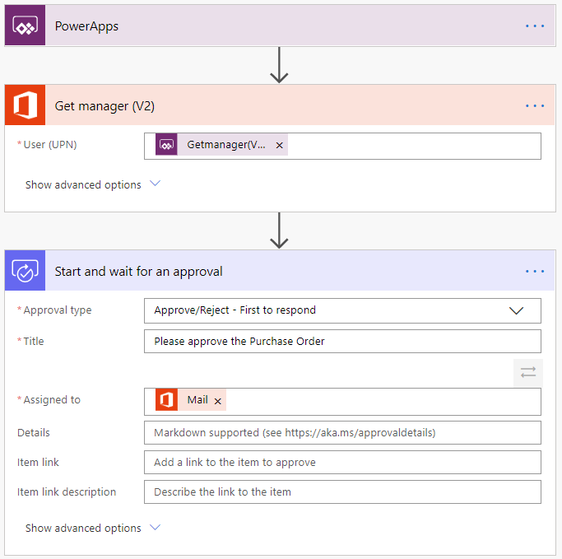
Example: Purchase order approval
Notes:
Approvals are a great process to build in Power Automate. They are often defined yet manual. Check out the following scenario for an example:
A user starts the process by going into a Power Apps app and creating a purchase order request. Once they submit the request, the information is sent to a Power Automate flow.
The flow can be built to evaluate the request and then route the request based on criteria such as submitting user and request amount. The first action could be to send the request to the user's manager. The manager could be automatically retrieved from Azure AD, avoiding prompting for duplicate information.
Here is the starting point of the flow.

Slide 10
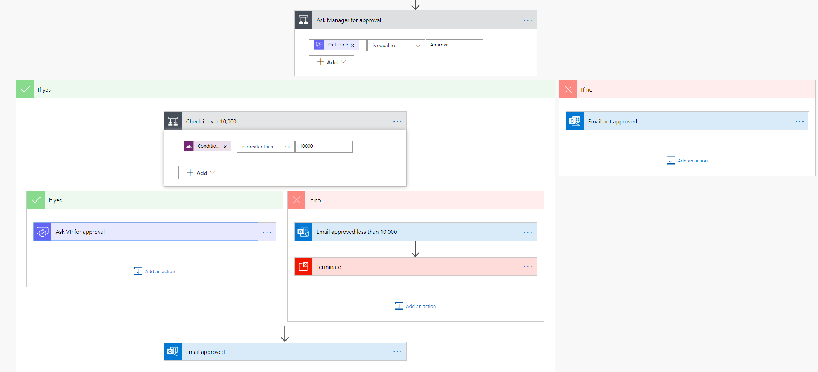
Example: Purchase order approval
Notes:
After the manager receives the approval and approves, the flow can then provide conditional logic. Typically this might be something like if the purchase order request is greater than $10,000 send it to VP if not then automatically approve the purchase order.
Here is an example of what this flow may look like.

Slide 11
Types of Power Automate flows
Event driven flows:
Flows built of a trigger to execute one or more actions
Business process flows:
Flows built to augment the experience when using Model-driven apps and Common Data Service
UI flows:
Robotic process automation (RPA) flows allow you to record yourself performing actions on your desktop or within a web browser
Notes:
Event driven flows - These are flows that you build with a trigger and then one or more actions. There are a multitude of triggers and actions available, thanks to the existing connectors. You will see these as My flows and Team flows in Power Automate. The only difference between a My flow and a Team flow is ownership. With a My flow you are the sole owner, while a Team flow has more than one owner.
Business process flows - These flows are built to augment the experience when using Model-driven apps and the Common Data Service. Use these to create a guided experience in your Model-driven apps.
UI flows - These robotic process automation (RPA) flows allow you to record yourself performing actions on your desktop or within a web browser. You can then trigger a flow to perform that process for you. You can also pass data in or get data out of the process, letting you automate even "manual" business processes.

Slide 12
Key concepts
Every flow has two main parts:
A Trigger:
The starting action of the flow such as new email arriving in your inbox or a new item being added to a SharePoint list
One or more Actions:
What you want to happen when a trigger is invoked such as start the action of creating a new file on OneDrive for Business
Notes:
Other examples of actions include sending an email, posting a tweet, and starting an approval.

Slide 13
Demo: Building a flow
Notes:
Use this opportunity to provide students with an overview of the application, and show them how to get to the different components. Show them how to create a Flow.

Slide 14
Exercise: Create your first flow
Follow the exercise in the student manual
Notes:
https://docs.microsoft.com/en-us/learn/modules/get-started-flows/2-create-first-flow

Slide 15
Exercise: Learn to use the Power Automate mobile app
Follow the exercise in the student manual
Notes:
https://docs.microsoft.com/en-us/learn/modules/get-started-flows/3-learn-to-use-flow-mobile-app

Slide 16
Exercise: Receive text and email notifications from flows
Follow the exercise in the student manual
Notes:
https://docs.microsoft.com/en-us/learn/modules/get-started-flows/4-flow-get-notifications

Slide 17
Exercise: Copy files with flow
Follow the exercise in the student manual
Notes:
https://docs.microsoft.com/en-us/learn/modules/get-started-flows/5-flow-copy-files

Slide 18
Exercise: Create recurring flows
Follow the exercise in the student manual
Notes:
https://docs.microsoft.com/en-us/learn/modules/get-started-flows/6-flow-scheduled-flows

Slide 19
Exercise: Send an email when a tweet is posted
Follow the exercise in the student manual
Notes:
https://docs.microsoft.com/en-us/learn/modules/get-started-flows/7-flow-post-tweets

Slide 20
Exercise: Create team flows
Follow the exercise in the student manual
Notes:
https://docs.microsoft.com/en-us/learn/modules/get-started-flows/8-flow-team-flows

Slide 21
Exercise: Troubleshoot flows
Follow the exercise in the student manual
Notes:
https://docs.microsoft.com/en-us/learn/modules/get-started-flows/9-troubleshoot-flows

Slide 22
Build more complex flows

Slide 23
Dynamic content

Slide 24
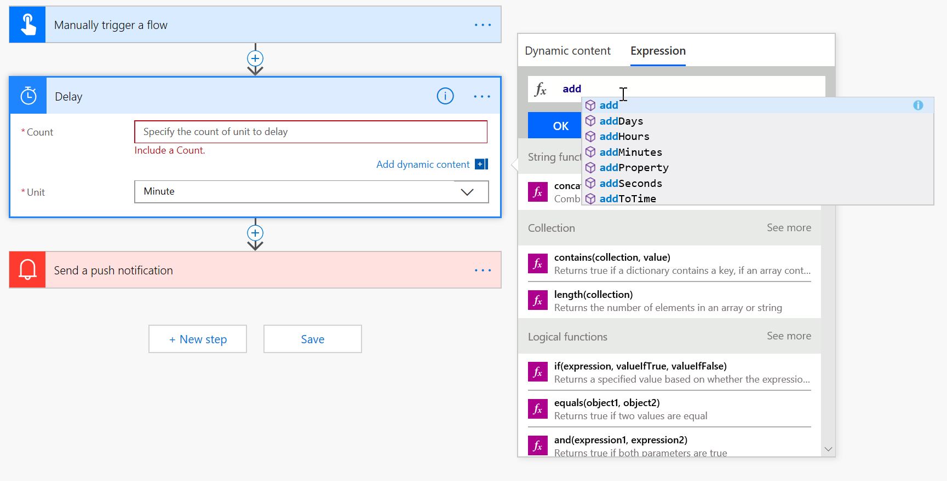
Expressions
Notes:
Many reasons to use expressions:
Convert types
Perform simple, inline calculations like string manipulation or arithmetic, or date/time manipulation
Generate data like the current time, a GUID or a random number
Handling optional values
“If” conditional statements / control flow
Working with lists

Slide 25
Exercise: Build an approval request
Follow the exercise in the student manual
Notes:
https://docs.microsoft.com/en-us/learn/modules/build-more-flows/2-flow-create-approval-request

Slide 26
Exercise: Build a flow that processes an approval
Follow the exercise in the student manual
Notes:
https://docs.microsoft.com/en-us/learn/modules/build-more-flows/3-flow-process-approval-request

Slide 27
Exercise: Create a flow that stores documents
Follow the exercise in the student manual
Notes:
https://docs.microsoft.com/en-us/learn/modules/build-more-flows/4-flow-store-documents

Slide 28
Exercise: Build a flow that uses information like locations or dates
Follow the exercise in the student manual
Notes:
https://docs.microsoft.com/en-us/learn/modules/build-more-flows/5-flow-use-tokens

Slide 29
Exercise: Build a flow that accepts user input when run
Follow the exercise in the student manual
Notes:
https://docs.microsoft.com/en-us/learn/modules/build-more-flows/6-flow-accepts-user-input

Slide 30
Exercise: Build a flow that runs at recurring time intervals
Follow the exercise in the student manual
Notes:
https://docs.microsoft.com/en-us/learn/modules/build-more-flows/7-flow-recurring

Slide 31
Exercise: Build a flow that runs when an event in Dynamics 365 occurs
Follow the exercise in the student manual
Notes:
https://docs.microsoft.com/en-us/learn/modules/build-more-flows/8-flow-event-d365

Slide 32
Exercise: Build a flow that uses SQL
Follow the exercise in the student manual
Notes:
https://docs.microsoft.com/en-us/learn/modules/build-more-flows/9-flow-use-sql

Slide 33
Exercise: Integrate Power Apps, Power Automate and SharePoint
Follow the exercise in the student manual
Notes:
https://docs.microsoft.com/en-us/learn/modules/build-more-flows/10-flow-integrate-powerapps

Slide 34
Exercise: Monitor Flows
Follow the exercise in the student manual
Notes:
https://docs.microsoft.com/en-us/learn/modules/build-more-flows/13-monitor-flows

Slide 35
Use the Admin center to manage environments and data policies in Power Automate

Slide 36
Administering flows
You can create a flow and perform administrative tasks in a browser or, if you download the Power Automate mobile app, on your phone:
Turn flows on or off from wherever you are
See when a flow has failed
Review detailed run history reports
View and filter runs by notification type
Notes:
You can create a flow and perform administrative tasks in a browser or, if you download the Power Automate mobile app, on your phone.
Here are some of the tasks you can perform with the mobile app:
Turn flows on or off from wherever you are.
See when a flow has failed.
Review detailed run history reports.
View and filter runs by notification type.

Slide 37
Administer flows
The Admin center is the central location where tenant admins and environment admins manage an organization’s data policies and environments:
Import and export flows
Share flows
Monitor flows
Notes:
Welcome to the Admin center! The Admin center is the central location where tenant admins and environment admins manage an organization's data policies and environments. Any changes that you make in the Admin center are immediately available to users in the organization.
In this module, you'll learn how to:
Import and export flows.
Share flows.
Monitor flows.

Slide 38
Environments
An environment is a space where you can store, manage, and share your organization’s business data, apps, and flows:
You can create separate environments to group the test and production versions of your apps
You can create separate environments that correspond to specific teams or departments in your company. Each environment holds the relevant data and apps for each team/ department
You can create separate environments for different global branches of your company
You can build all your apps in a single environment
Notes:
An environment is a space where you can store, manage, and share your organization's business data, apps, and flows. It also serves as a container to separate apps that might have different roles, security requirements, or target audiences.
The way that you use environments depends on your organization and the apps that you're trying to build. Here are some examples:
You can create separate environments to group the test and production versions of your apps.
You can create separate environments that correspond to specific teams or departments in your company. Each environment holds the relevant data and apps for each team/department.
You can create separate environments for different global branches of your company.
You can build all your apps in a single environment.

Slide 39
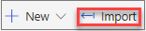
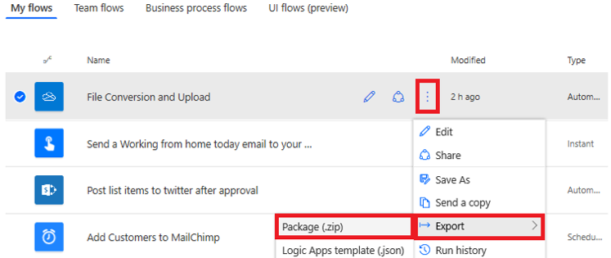
Export a flow
Import a flow:
After a flow has been exported, it can be imported by anyone that you send the zip file to.

Slide 40
Exercise: Export and import flows
Follow the exercise in the student manual
Notes:
https://docs.microsoft.com/en-us/learn/modules/administer-flows/2-flow-export-import

Slide 41
Exercise: Distribute button flows
Follow the exercise in the student manual
Notes:
https://docs.microsoft.com/en-us/learn/modules/administer-flows/3-share-flows

Slide 42
Introduction to business process flows

Slide 43
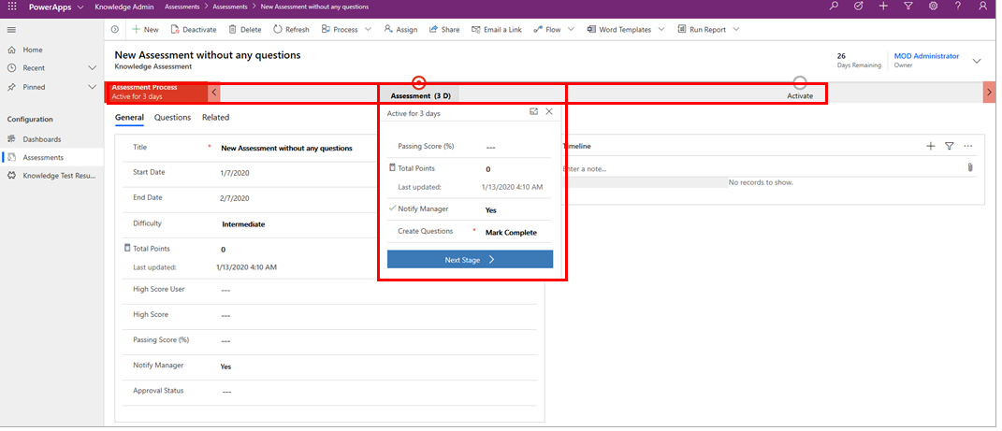
Introduction to business process flows
A business process flow is a series of ordered work steps that a user completes within a business process
Notes:
A business process flow is a series of ordered work steps that a user completes within a business process. In Microsoft Power Automate, a business process flow is composed of a series of discrete stages that leads a user along a path toward process completion. Each stage contains one or more fields (called data steps) that you should complete before proceeding to the next stage in the business process flow.
A business process flow visually guides a user through stages within a process and shows progress toward process completion. A user can also see which stages that they have completed and which stages that they still need to complete within an instance of a process.
Business process flows can be configured to require users to enter information into certain fields (data steps) before completing the stage and, if needed, you can also allow users to jump stages. All data that is collected while you are completing a business process flow is stored in one or more entities in Common Data Service.
The following illustration shows a simple business process flow with two stages for adding questions to a survey. The business process flow is shown as a component of a model-driven solution in Power Apps.
Business process flows are created and managed by using Power Automate, and they are available for out-of-the-box entities and for your own custom entities. Microsoft has many prebuilt business process flows, or you can create your own. Additionally, an entity can have none, one, or many business process flows associated with it. Business process flows are customizable to fit many organizational needs.
[!TIP] Business process flows are meant to guide users through steps that are required to complete a business process. You must have a valid Power Apps Dynamics 365 license or a valid Power Apps license to create or use a business process flow.

Slide 44
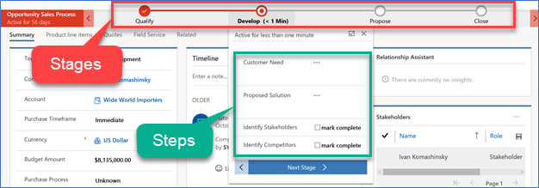
Business process flows
A guide, roadmap,
recipe, …
Stages and steps
Stage gating
Conditional branching
Include multiple entities
Switch at any time
Role tailored
Automation and Developer APIs
Notes:
Spend as much time as necessary making sure the audience has an understanding of the basics of Business Process Flows

Slide 45
When to use business process flows
Want to create automated business processes with Dynamics 365 Solutions
Want a simple visual guide to help users complete a process
Want to use out-of-the-box business process flows
Have a Dynamics 365 license and want to create automated business processes with Common Data Service
Notes:
Knowing when to use a business process flow or a regular Power Automate flow to automate a processes or task can be difficult. The following guidelines can help you decide if you should use a business process flow or a standard Power Automate flow.
Use a business process flow if you:
Want to create automated business processes with Dynamics 365 Solutions.
Want a simple visual guide to help users complete a process.
Want to use out-of-the-box business process flows.
Have a Dynamics 365 license and want to create automated business processes with Common Data Service.

Slide 46
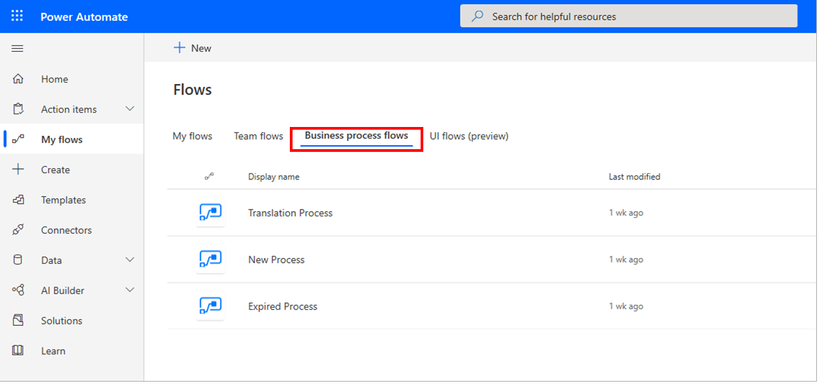
How is it different from a Power Automate Flow?
Business process flows offer the following benefits:
Improved outcomes
Consistent stages and work steps across all instances of the process
Improved data collection and reporting
Decreased time to complete the process
Predictable outcomes
Notes:
A business process flow is a visual guide that is meant to help users complete a business process by using a set of predefined stages. Users are not limited on how long they run a business process or how long they have a stage open. All data that is associated with the business process flow can only be stored in one or more entities in Common Data Service, and you cannot associate a business process flow with another data source behind it.
Common Data Service has many different out-of-the-box business process flows that you can use in its current state or modified to fit your needs.
A Power Automate flow does not have any visual components like a business process flow. Power Automate flows can be configured to work with many different data sources and a flow can connect to many different data sources within the same flow. A flow can be configured to time out if it is not completed in a certain time and can be triggered to move between steps based on data or user interaction. Flows support complex logic and looping and a Power Automate flow can call another Power Automate flow as needed.
Business process flows allow organizations to quickly standardize how processes are completed and what data is collected at each stage. Business process flows support logical branching so they can be used to standardize many common business processes within an organization.
Business process flows offer the following benefits:
Improved outcomes
Consistent stages and work steps across all instances of the process
Improved data collection and reporting
Decreased time to complete the process
Predictable outcomes
Improved outcomes
Consistent stages and work steps across all instances of the process
Improved data collection and reporting
Decreased time to complete the process
Predictable outcomes
Business process flows are simple to set up and administer. Business process users who are close to business operations and processes can create new business process flows or modify out-of-the-box business process flows by using Power Automate.
Business process flows can be customized based on security roles, allowing access to the appropriate stages and steps based on a security role. Finally, the process of each instance of a business process flow can be monitored, and the data from the process flow can be used in Power BI dashboards and reporting for simplified administration.
Business process flows are deeply integrated with the Microsoft Power Platform. They are created, customized, and managed by using Power Automate. You can manage or create new business process flows by launching Power Automate and selecting Business process flows under My Flows in Power Automate, as shown in the following image.

Slide 47
When to use
Business Process Flow
Power Automate Flow
Want to create automated business processes with CDS Solutions
Start based on a predefined time interval or after X minutes, hours, or days of some action or event
Want a simple visual guide to help users complete a process
Want to trigger a flow based on data outside of Common Data Service (SharePoint, for example)
Want to use out-of-the-box business process flows
Do not want to store data that is captured in the flow in Common Data Service
Have a Dynamics 365 license and want to create automated business processes with Common Data Service
Want to push notifications outside of Outlook (SMS or Gmail, for example)
Want to use and create workflows with only an Office 365 license
Notes:
A business process flow is a visual guide that is meant to help users complete a business process by using a set of predefined stages. Users are not limited on how long they run a business process or how long they have a stage open. All data that is associated with the business process flow can only be stored in one or more entities in Common Data Service, and you cannot associate a business process flow with another data source behind it.
Common Data Service has many different out-of-the-box business process flows that you can use in its current state or modified to fit your needs.
A Power Automate flow does not have any visual components like a business process flow. Power Automate flows can be configured to work with many different data sources and a flow can connect to many different data sources within the same flow. A flow can be configured to time out if it is not completed in a certain time and can be triggered to move between steps based on data or user interaction. Flows support complex logic and looping and a Power Automate flow can call another Power Automate flow as needed.
Business process flows allow organizations to quickly standardize how processes are completed and what data is collected at each stage. Business process flows support logical branching so they can be used to standardize many common business processes within an organization.
Business process flows offer the following benefits:
Improved outcomes
Consistent stages and work steps across all instances of the process
Improved data collection and reporting
Decreased time to complete the process
Predictable outcomes
Improved outcomes
Consistent stages and work steps across all instances of the process
Improved data collection and reporting
Decreased time to complete the process
Predictable outcomes
Business process flows are simple to set up and administer. Business process users who are close to business operations and processes can create new business process flows or modify out-of-the-box business process flows by using Power Automate.
Business process flows can be customized based on security roles, allowing access to the appropriate stages and steps based on a security role. Finally, the process of each instance of a business process flow can be monitored, and the data from the process flow can be used in Power BI dashboards and reporting for simplified administration.
Business process flows are deeply integrated with the Microsoft Power Platform. They are created, customized, and managed by using Power Automate. You can manage or create new business process flows by launching Power Automate and selecting Business process flows under My Flows in Power Automate, as shown in the following image.

Slide 48
Create an immersive business process flow

Slide 49
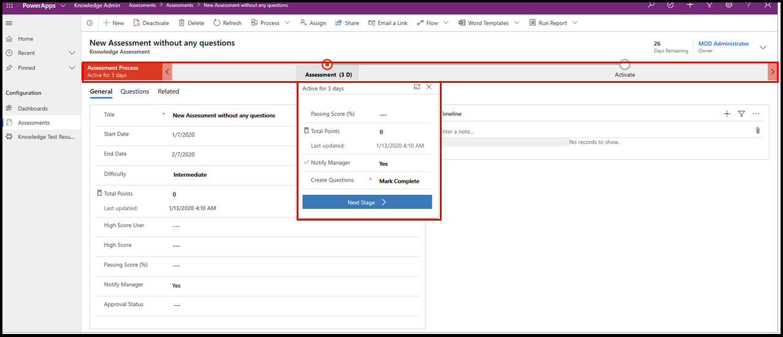
Types of business process flows
Embedded: Embedded within a model-driven app
Immersive: Stand-alone solution
Notes:
Business process flows are available in two different varieties: embedded within a model-driven app and as a stand-alone solution called an immersive business process flow. You should examine the differences between each before learning how to create an immersive business process flow.
Embedded business process flows are visual representations of a series of work steps within an end-to-end process. They always appear along the top of a model-driven app in their own control, as shown in the following image.

Slide 50
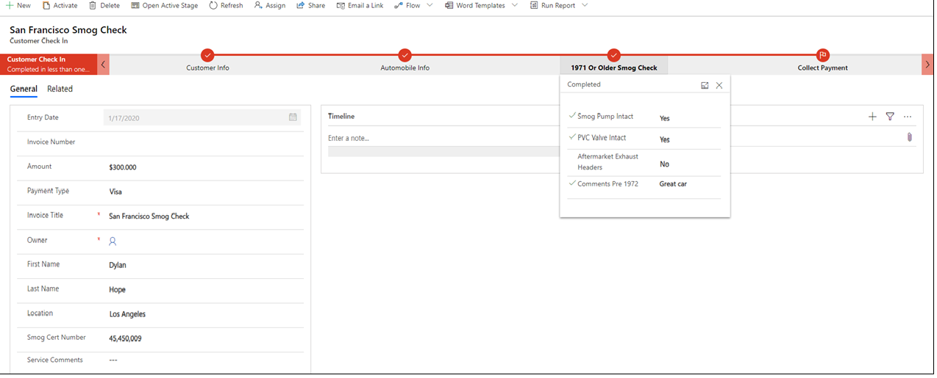
Launching business process flows
Can be launched as a component of a model-driven Power App or a stand-alone application within Power Automate (called an immersive business process flow), as shown in the following image
Notes:
You can launch the new business process flows as a component of a model-driven Power App or a stand-alone application within Power Automate (called an immersive business process flow), as shown in the following image.
As mentioned previously, all data that is associated with a business process flow is stored in one or more Common Data Service entities (custom or standard). You could launch an instant Power Automate flow in conjunction with a business process flow to store data outside of Common Data Service if needed. Additionally, you can create Power BI dashboards from the data that was collected within the business process flow.
Business process flows are deeply integrated within Power Platform and offer powerful ways to improve how you manage common business processes.

Slide 51
Exercise: Create an immersive business process flow
Follow the exercise in the student manual
Notes:
Alternative link
https://docs.microsoft.com/en-us/learn/modules/create-immersive-flow/2-immersive-flow

Slide 52
Exercise: Run the business process flow and view data
Follow the exercise in the student manual
Notes:
Alternative link
https://docs.microsoft.com/en-us/learn/modules/create-immersive-flow/3-run-flow

Slide 53
Introduction to Power Automate security and governance

Slide 54
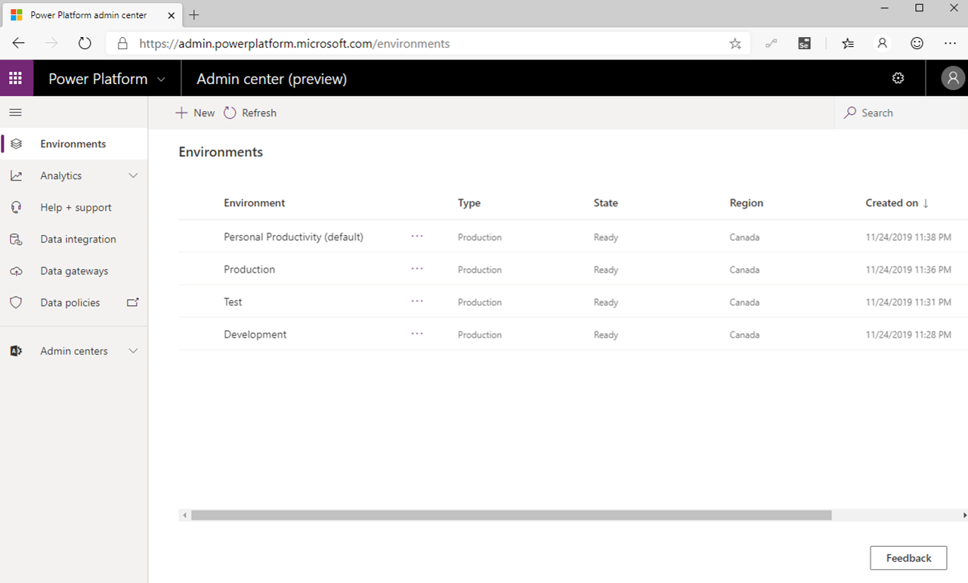
Identify Power Platform environments
Environments are an important consideration when you are trying to help secure and govern Power Apps and Power Automate usage
Notes:
Environments are an important consideration when you are trying to help secure and govern Power Apps and Power Automate usage. Environments act as a security container for apps and flows to run within. Every flow must be assigned to an environment. Every licensed user belongs to the default environment.
Additional environments can be provisioned where opt-in access is possible. A strategy that some organizations adopt includes renaming the default environmentto be called Personal Productivity, which implies permission to build flows that improve their own productivity.
Organizations can subsequently create additional environments for development, testing, and production purposes. Using this strategy might also align flow creation with existing IT change management requirements.
By default, anyone can create environments, but administrators can also control who can create and manage environments in the Power Platform Admin centerand limit it to a set of administrators.
When creating an environment, organizations can choose which region they want their environment to reside in. This approach is important because it allows organizations to store data closer to actual users and to maintain and meet compliance requirements for their geography. Regions already available to store data include Asia, Australia, Canada, Europe, France, India, Japan, South America, United Kingdom, United States, and US Government (GCC).
Regions are also important when it comes to Admin Analytics because the Power Platform Analytics feature isolates analytics through environments. The telemetry that is generated in one region is not allowed to leave that region. For administrators to view analytics, they need to select an environment first before they can view telemetry.

Slide 55
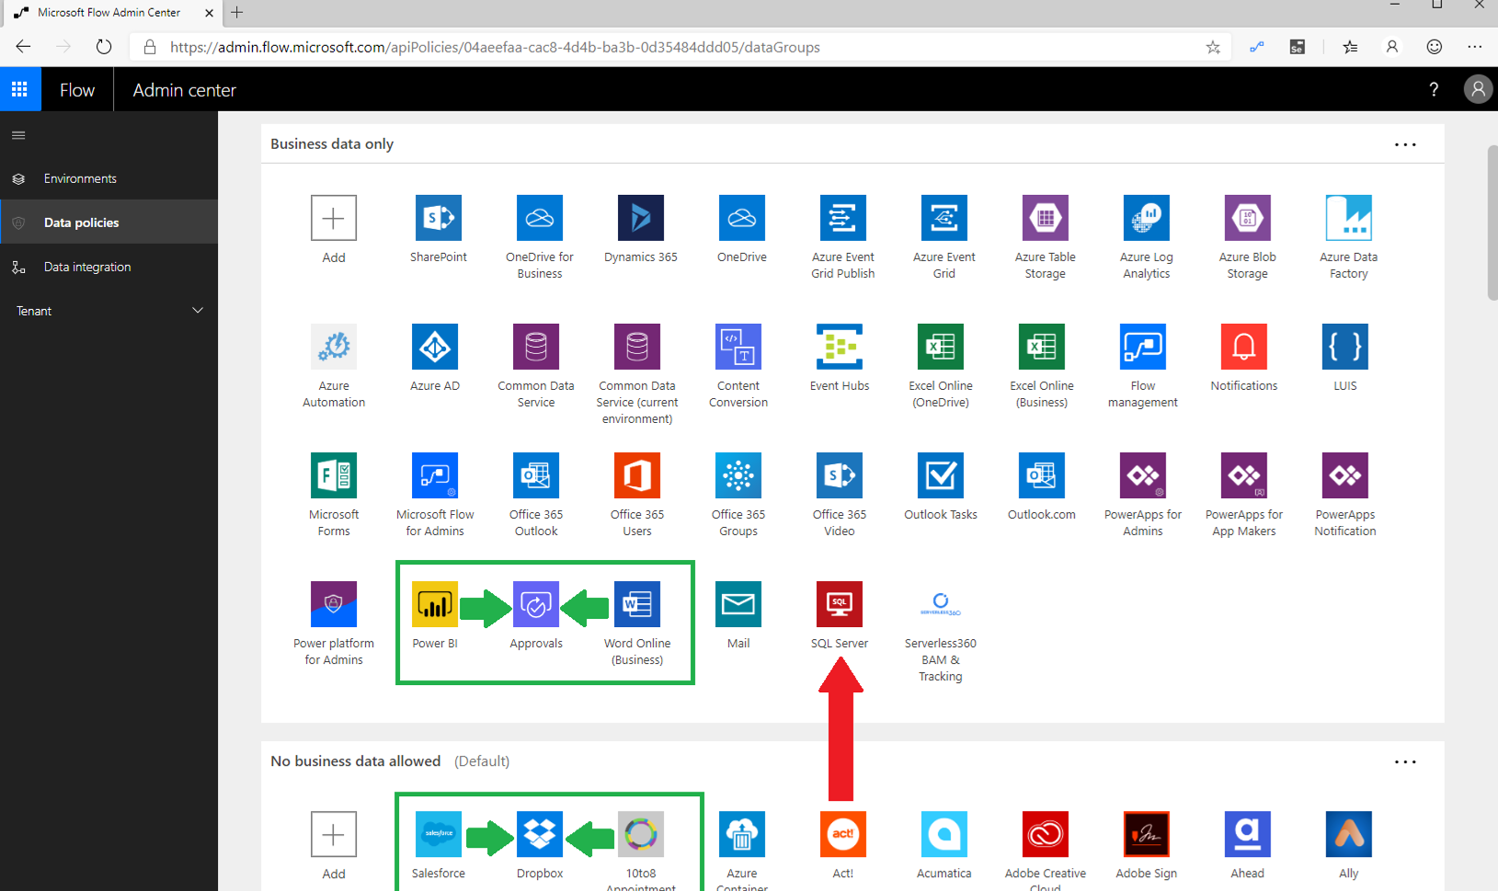
Data Loss Prevention policies
Data Loss Prevention (DLP) policies allow organizations to construct rules that permit and prevent connectors from communicating with each other within the same flow
Notes:
Data Loss Prevention (DLP) policies allow organizations to construct rules that permit and prevent connectors from communicating with each other within the same flow. Microsoft accomplishes this task by establishing two data groups: Business data only and No business data allowed. The intent of these two data groups is to put connectors that have the same data profile in the same data group. Grouping connectors means that they can communicate with each other within the same data group but are not able to communicate across data groups.
To illustrate this concept, consider the following scenario where connectors have been distributed across the two data groups. You want to build a flow that includes the Microsoft Word Online, Approvals, and Power BI connectors. Because all of these connectors belong to the Business data only data group, you can confidently create and run this flow.
Similarly, in the No business data allowed data group, you can combine the Salesforce, Dropbox, and 10to8 Appointment connectors within the same flow because they all belong to the same data group. However, you cannot create a flow that includes the SQL Server connector and Act! connector because they belong to different data groups. If you want to create a flow that included these two connectors, you will need to move one of the connectors into the other data group.

Slide 56
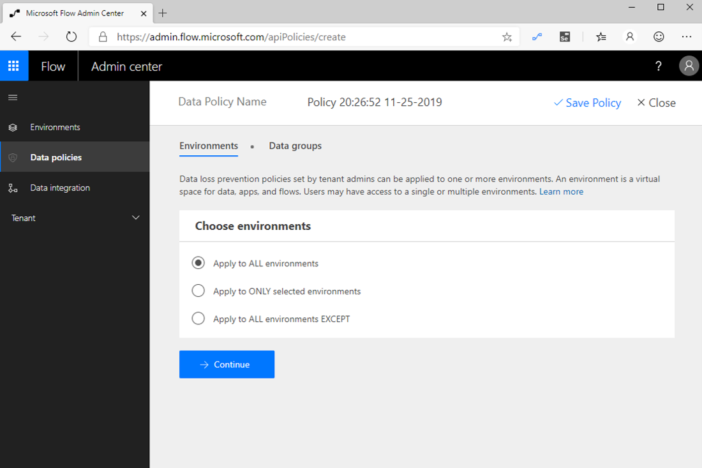
Data Loss Prevention policies
When a DLP author selects Apply to ALL environments, this setting also ensures that new environments have this DLP policy applied
Notes:
Additionally, you can specify one data group to be the default data group. Beside the name of the default data group is the (Default) label appended. To change the default data group, select the ellipsis (...) in the upper-right corner of the data group.
The default data group is significant because it becomes the data group that all new connectors are added to. For example, if Microsoft deploys a new connector to the Power Automate service, that connector will be added to the default data group. This behavior is also true for custom connectors that are deployed to an environment.
DLP policies can belong to two different scopes: environment and tenant. An environment-scoped DLP policy only applies to that specific environment, whereas a tenant-scoped DLP policy applies to all environments in that tenant. When creating a new DLP policy, policy authors have a few options that they can choose from, including the ability to Apply to ALL environments (tenant), Apply to ONLY selected environments, and Apply to All environments EXCEPT.
When a DLP author selects Apply to ALL environments, this setting also ensures that new environments have this DLP policy applied.
Environments can have multiple DLP policies applied, which provides for more governance scenarios to be implemented. However, when multiple DLP policies have been implemented, the most restrictive policy is applied. DLP policy layering is discussed further in the Planning module.
Configuring DLP policies depends on an organization's design and cyber security principles. For some organizations, these principles allow for the mixing of business-related connectors with consumer-based services. Other organizations might choose to strictly prevent business-related connectors from connecting with consumer-based services. Organizations should begin by cataloging the business systems that exist within their organization and then creating DLP policies that align with that business mapping. DLP strategies are discussed further in the Implementation recommendations for Power Automate environments module of this learning path.
Organizations should also carefully evaluate which data group they would like to declare as their default data group. Regardless of which data group they designate, administrators should pay attention to new connectors that are being deployed into environments so they can place them into the appropriate data group. How administrators can detect these new connector events is discussed further in the Use templates to enforce governance policies in Power Automate module of this learning path.

Slide 57
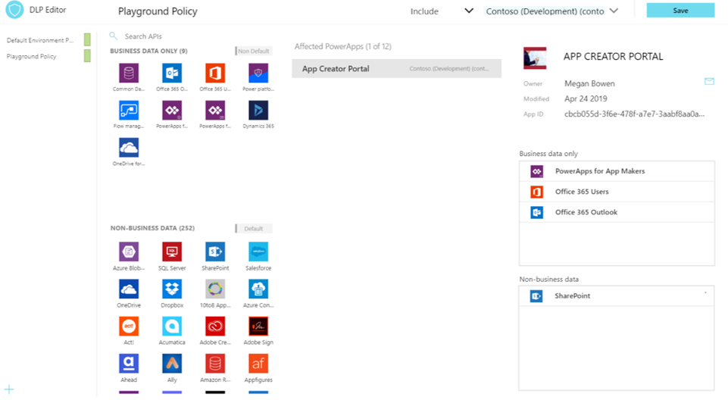
Power Platform Center of Excellence Starter Kit
The Power Platform Center of Excellence (COE) Starter Kit is a set of apps, flows, a custom connector, and a Power BI dashboard that allows organizations to govern their Power Platform environments
Notes:
The Power Platform Center of Excellence (COE) Starter Kit is a set of apps, flows, a custom connector, and a Power BI dashboard that allows organizations to govern their Power Platform environments. The tool is freely available for download on GitHub.
The Starter Kit is a great tool for organizations to increase the visibility of what their makers are doing in their tenant. Naturally, this tool immediately applies to two personas: Cyber Security analysts and Organizational Change Management (OCM) interests. Makers that are building applications and services that introduce risk to the organization should be monitored, but makers who are automating workloads within sanctioned systems and services should be empowered and encouraged to expand on their efforts.
The Starter Kit does have some prerequisites, including:
A global tenant admin, Power Platform Service admin, or Dynamics 365 service admin role is required to access the tenant resources.
A Power Apps premium license for accessing Common Data Service.
An environment with Common Data Service because the Starter Kit solution will need to store metadata about the apps and flows that are detected within an environment.
Power BI Desktop to view the reports and visualizations that highlight app and flow use within the tenant.
A global tenant admin, Power Platform Service admin, or Dynamics 365 service admin role is required to access the tenant resources.
A Power Apps premium license for accessing Common Data Service.
An environment with Common Data Service because the Starter Kit solution will need to store metadata about the apps and flows that are detected within an environment.
Power BI Desktop to view the reports and visualizations that highlight app and flow use within the tenant.
Within the Starter Kit, administrators will discover the tools and features that are discussed in the following sections.
By using the DLP Editor app, an administrator can explore existing DLP policies and evaluate the impact of moving a connector from one data group to another. If a change to a data group has an impact on an existing app, that will be highlighted in the Affected Power Apps list. Then, an administrator can send an email, through an in-app experience, to the owner of that application and warn them of the upcoming change.
This current, in-product DLP editor experience doesn't provide this type of what-if analysis, so we recommend that you use the DLP Strategy app that comes with the COE Starter Kit when making DLP changes. Using the DLP Strategy app will also help you understand the impact to existing apps when DLP changes are made and help you reduce the chance of unknowingly breaking someone's app.

Slide 58
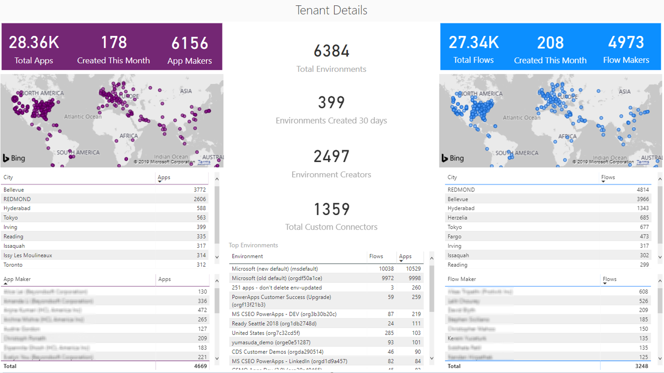
Power Platform Center of Excellence Starter Kit
The Power BI dashboard connects to Starter Kit Common Data Service entities and contains tabs that provide the following reports:
Notes:
While Admin Analytics, which is found in the Power Platform Admin center, provides some insight into the use of Power Apps and Power Automate, it does so within the context of an environment. This parameter makes developing a holistic picture of usage difficult. However, using the tools that are provided in the COE Starter Kit brings all these insights together by using Common Data Service, a model-driven Power App, and a Power BI dashboard. These assets, plus the inclusion of flows that will sync data from Office 365 Security and Compliance logs and through the Power Platform management connectors into Common Data Service entities, provide the greatest level of visibility for administrators.
The Power BI dashboard connects to Starter Kit Common Data Service entities and contains tabs that provide the following reports:

Slide 59

Power Platform Center of Excellence Starter Kit
Connections – Displays the number of connections that have been established, by connector
Notes:
Overview - Includes the total number of apps and flows that have been created, including a breakdown based on the maker's location and the number of apps/flows that they have created.
Environments - Highlights the number of environments that have been created and includes the type of environment (Default, Production, Sandbox, Trial), and then identifies the creators of the environments and when the environment was created.
Apps - Provides insights into the usage of apps, including the number of sessions and users that the app has been shared with. This report also breaks down usage by department by pivoting data based on the department that has been specified inside of a user's Office 365 profile.
App detail - Examines the specifics of the app, including the connection type and when the app was last published.
Flows - Displays a flow creation trend that will break down when flows were created. This report will also pivot data based on the user's department and includes a breakdown of the flows that were created by environment.
Custom Connectors - Lists all the custom connectors that exist within a tenant. This report also lists the users that created the connectors and then trends the month that they were created in.
Makers - Identifies all the makers within the environment and identifies how many apps and flows they have built. A slicer exists that allows a consumer of this report to filter based on the maker's department.
Connections - Displays the number of connections that have been established, by connector. This report provides great insight into the popularity of specific connectors within your tenant.

Slide 60
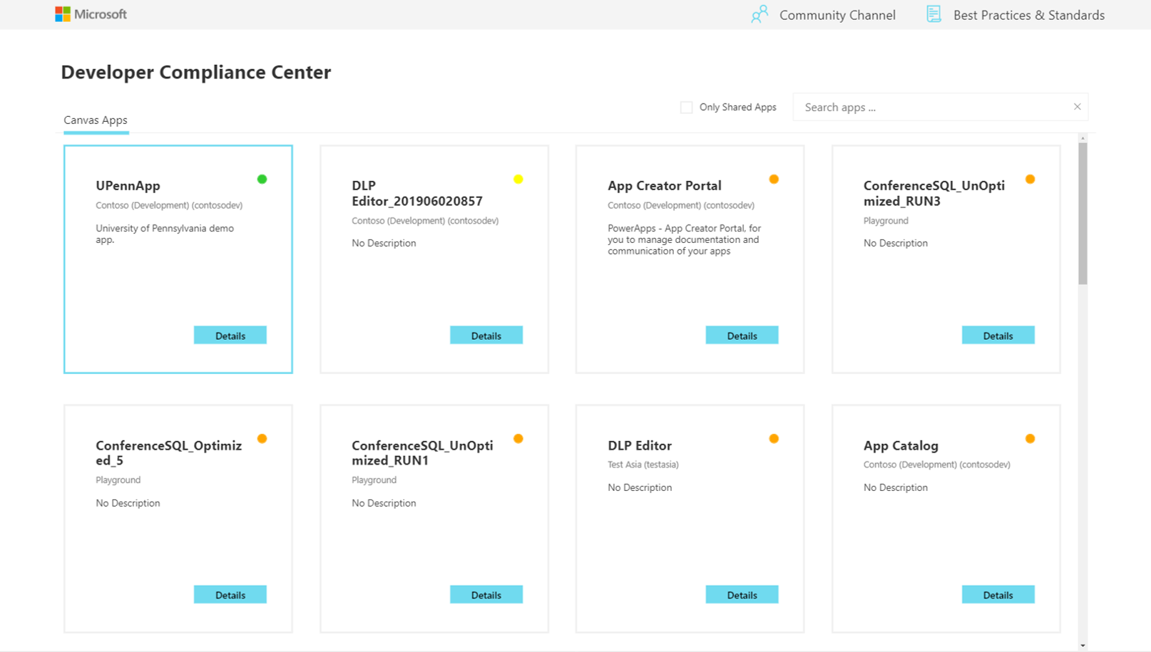
Power Platform Center of Excellence Starter Kit
The main purpose of the Sample App Audit process is to demonstrate how an admin could identify overshared or often used resources and gather further information, like business justification and business impact of an outage, for those apps
Notes:
The main purpose of the Sample App Audit process is to demonstrate how an admin could identify overshared or often used resources and gather further information, like business justification and business impact of an outage, for those apps. Having a platform that provides democratized access to technology is only useful if people don't create many redundant or low-value applications. Situations might also occur where people create temporary applications for proof-of-concept purposes. These apps can clutter an environment if they are not cleaned up. Within the COE Starter Kit, app makers can be prompted to attest their application to ensure that it addresses business justification requirements. If the application doesn't address these requirements, makers can have their application removed from the environment.

Slide 61
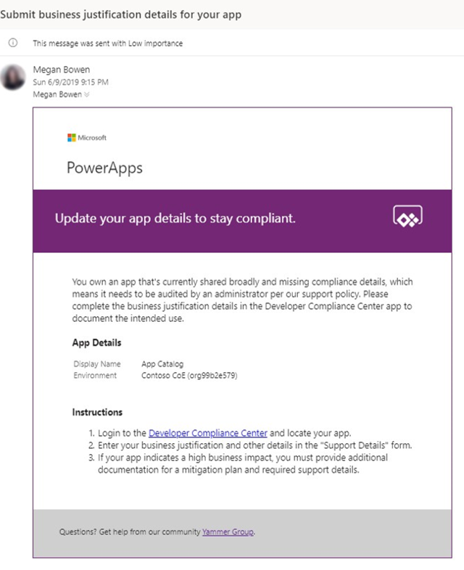
Power Platform Center of Excellence Starter Kit
Administrating access to applications can be done by the Owner of the application
Notes:
The App Catalog application acts as a catalog that helps with discoverability of apps. Users can explore featured apps and browse apps by category. The app catalog can be a great entry point to launch apps for end users and makers can explore to see if an application already exists before they create another app that provides similar functionality. An Admin decides which apps are featured in the App Catalog by completing the App Audit process. After an app has been approved by the App Audit process, these apps can be featured in the app catalog.
Administrating access to applications can be done by the Owner of the application. However, circumstances might occur where you want an administrator to provide access. By using the Set Owner app, you can allow for this situation by selecting an app, adding users, and then indicating whether they should be able to view the app or edit the app.

Slide 62
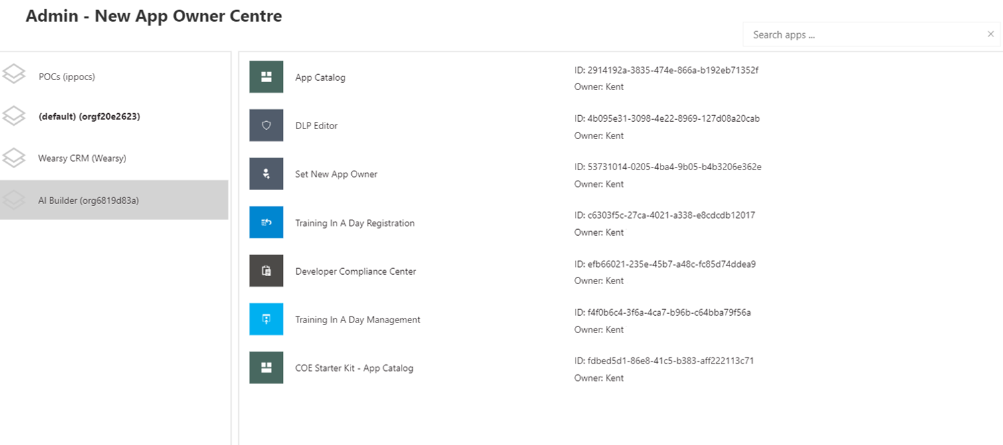
Power Platform Center of Excellence Starter Kit
Detecting when a maker has created their first app or flow and sending them some useful information to accelerate their journey will immediately imply that these tools are the ones that they are permitted to use
Notes:
Power Apps and Power Automate can be discovered virally within an organization's tenant through the Office 365 portal. Makers might be confused about whether they are allowed to use these tools or not.
Detecting when a maker has created their first app or flow and sending them some useful information to accelerate their journey will immediately imply that these tools are the ones that they are permitted to use. Now, they will have a list of resources that can ease their transition into using these tools.

Slide 63
Understand advance business process flow concepts

Slide 64
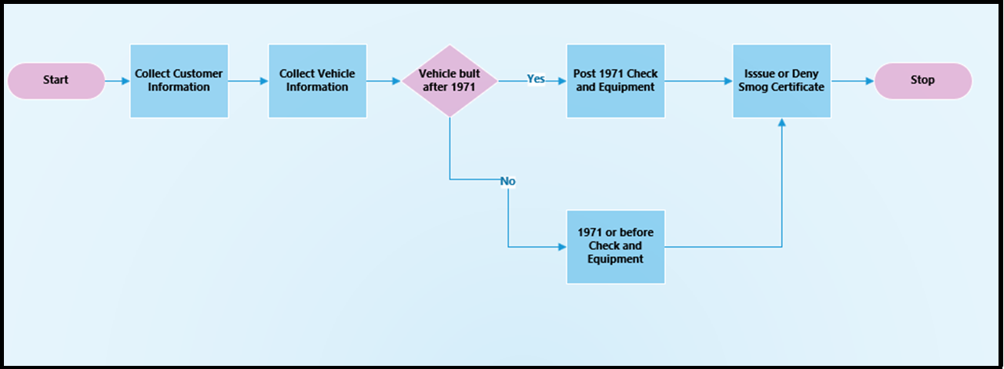
Introduction to logical branching in business process flows
The previous module of this learning path explained how to create a simple, two-step linear business process flow.
Notes:
The previous module of this learning path explained how to create a simple, two-step linear business process flow. Some business processes are simple step-by-step sequential workflows, but many processes might need branching logic that requires one set of stages for one condition and another set of stages for an alternative condition. Think of this logic as a simple if then else statement.
Logical branching requires a decision point and a test of a value or condition. If a condition matches a certain value, then the flow goes through one branch with one or many stages; if it does not, then the flow goes through another set of one or many stages. Occasionally, the two logical paths will meet at a rendezvous point; other times, they will not. The following sections explore how you can use logical branching with business process flows.
Branching logic is useful when you are trying to model a business process to standardize data collection and improve process outcomes. Logical branching enables the creation of business process flows that can adapt to different conditions within the same flow instead of having to create and launch many different flows to handle one condition or another.
For example, consider the scenario from the previous module, where customers refer to the fictitious company SmogChecksRUs for bi-annual smog checks on their vehicles. In many jurisdictions, different requirements are in place for emission control standards and equipment based on the year of the vehicle manufacture. It would be useful to be able to model all required tests within a single business process flow. You can accomplish this task by using logical branching within a business process flow.
The following diagram models the branching business logic that you need to build into your flow.
The business process flow logical diagram shows that the smog equipment and the required checks are different for vehicles that are built before or during 1971 and after 1971. As a result, you need to add a logical branch to check the year when the vehicle was manufactured, collect different information, and then perform different checks on vehicles that are built after 1971. The exercises at the end of this module explain how to build a business process flow to manage this scenario.
Unfortunately, business process flows have some limitations on what can be modeled with logical branching. The following sections examine what types of logical branching can't be modeled and built in business process flows today.
Occasionally, you will want to model a business process that has multiple branches, and not all branches end up at the same rendezvous stage. Currently, this situation is not allowed in a business process flow. An example of an unsupported flow is shown in the following image.
Notice the choices that exist around the Vehicle Service decision point. Two of the branches end up at the Issue or Deny Smog Certificate stage and then move into the Collect Payment stage, whereas the top branch skips the Issue or Deny Smog Certificate stage and then ends at the Collect Payment stage. This logical model is not supported. All stages at a decision point must resolve to the same stage, and cannot have intermediate stages for some but not other branches.
The root of the problem in the preceding figure is that the logic is not modeled properly. The decision stage is modeling two if then else conditions and not one. A better way to model this logic is to add a second decision point, as shown in the following figure. The approach that is shown in the diagram is supported because the decision stages are each testing one condition and all resolve to a single stage.
Study this example so you understand how to add another logical branch and model business process flows correctly.

Slide 65
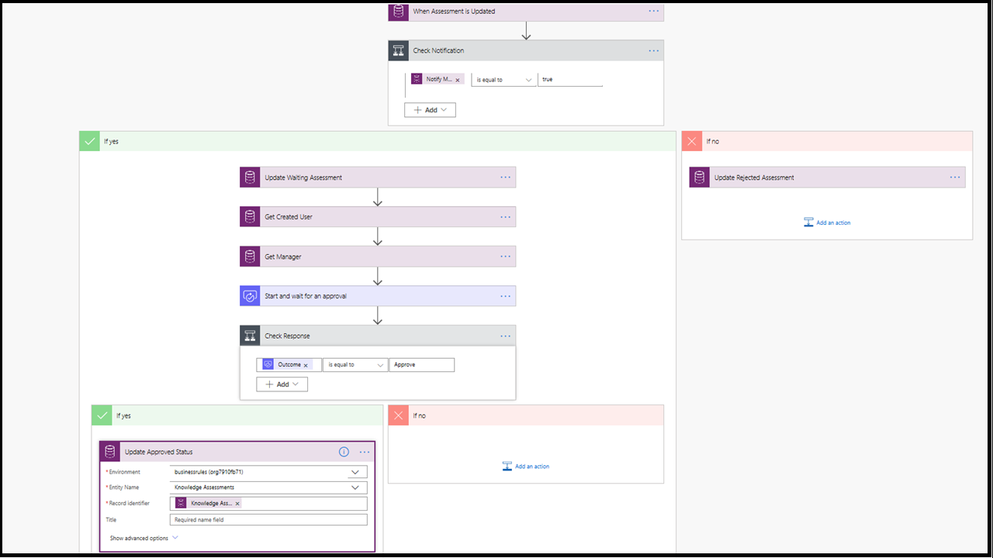
Instant flows
Business process flows aren't the exclusive workflow automation option that is available to an entity in Microsoft Dataverse.
Notes:
Business process flows aren't the exclusive workflow automation option that is available to an entity in Microsoft Dataverse. In fact, a single business process flow can run against up to five entities in Common Data Service. Dynamics 365 workflows are also supported as part of a business process flow. This topic is beyond the scope of this learning path, but if you are interested in this topic, you can learn more about Dynamics 365 workflows by selecting the related link in the summary unit of this module.
A third workflow automation, called instant flows, in Power Automate offers a powerful capability that can supplement business process flows.
Microsoft Power Automate offers instant workflows that can run (trigger) automatically based on a schedule, time, data value, or if a record is added, selected, or modified. These workflows can work in conjunction with a business process flow to gather approvals, copy data from Dataverse to another data source, or trigger an email notification to specific users to alert them that something has changed and needs their attention. You can make instant flows that automatically trigger based on a record that is created, deleted, or modified, or you can make the flows run (trigger) by having a user select a button within a step in a stage.
Instant flows are made with Power Automate and they start with a single trigger followed by a series of actions. The following figure shows an example of an instant flow that sends an approval request to a user when a record in an entity in Dataverse is modified. In the exercises at the end of this module, you'll create an instant workflow in Power Automate and add it to your business process solution.
Business process flows work within Power Platform and many options are available, including instant flows and approval flows that can run in concert with a business process flow.
Business process flows don't exclude the possibility of adding more capabilities to the envisioned solution by using additional components of Power Platform like Power Apps, Power Automate instant flows, or Power BI Dashboards. You can read more about instant flows by selecting the related links in the summary unit within this module.

Slide 66
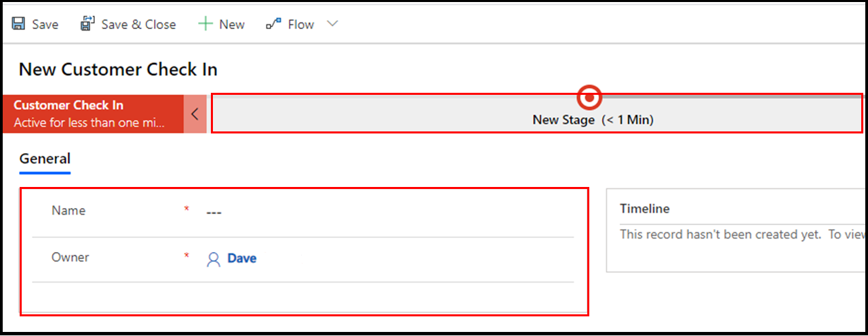
Enhance the form to augment a business process flow
Examine the business process flow that was created in the exercise for the previous module, Create an immersive business process flow in Power Automate.
Notes:
Examine the business process flow that was created in the exercise for the previous module, Create an immersive business process flow in Power Automate. Review the following screenshot and notice the visual representation of the process flow and a form under the business process flow called General, which contains only the Name and Owner fields.
If you want to add more fields to a form such as this, it would be beneficial. For example, if you want to record the amount of the invoice, you could record an autogenerated invoice number and then add general notes about the service that you completed for a customer.
Adding more fields and displaying them on a form that is associated with an immersive business process flow can be simple and quick. These flows are powerful, and you are only limited by your imagination and skill.

Slide 67
Exercise: Add branching logic to a business process flow
Follow the exercise in the student manual

Slide 68
Exercise: Add an instant flow
Follow the exercise in the student manual

Slide 69
Exercise: Enhance the main form that is associated with the business process flow
Follow the exercise in the student manual

Slide 70
Introduction to expressions in Power Automate

Slide 71
Introduction to expressions
When you build a flow in Power Automate, it is easy to get started by adding a trigger and actions and then passing data between them with dynamic content.
In Power Automate, expressions are a set of simple functions that enable you to return data. Put simpler, you use expressions to write a formula to get your data the way you want it. Expressions allow you to do things like convert a date to UTC, divide two numbers, create that perfect string by combining fields, and much more all by using various functions.
Notes:
When you build a flow in Power Automate, it is easy to get started by adding a trigger and actions and then passing data between them with dynamic content. But, sometimes you need to do more. You want the ability to do a calculation or to transform data for your solution. To do these things, you can look to expressions.
In Power Automate, expressions are a set of simple functions that enable you to return data. Put simpler, you use expressions to write a formula to get your data the way you want it. Expressions allow you to do things like convert a date to UTC, divide two numbers, create that perfect string by combining fields, and much more all by using various functions.
Flows in Power Automate run on top of Azure Logic Apps. The most important reason for you to understand that is that they both use all of the same functions. When you are searching the internet for solutions or reading documentation about flow functions, it is common to end up looking at Logic Apps documentation. For example, the Reference Guide of functions for Power Automate is hosted on the Logic Apps side of the documentation.
Through the remainder of this module, you will learn about the different types of functions and the syntax so you can start to use expressions in your flows.

Slide 72
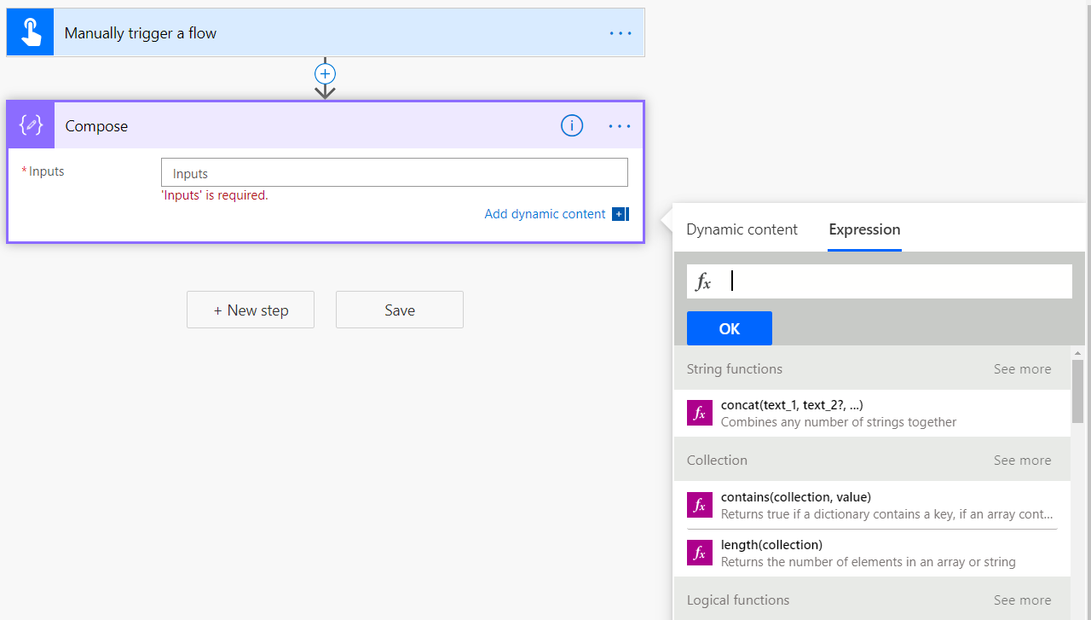
Get started with expressions
To write an expression in flow, you select in a field to open the Dynamic content menu and then you select "Expression" as shown below.
Notes:
To write an expression in flow, you select in a field to open the Dynamic content menu and then you select "Expression" as shown below.
[!div class="mx-imgBorder"] open the Dynamic content menu and select Expression
In the formula box, you will then write your expression by combining one or more functions. Before you learn about the different types of functions and their usage, there are some commonalities you should learn first. Function names are not case-sensitive.
[!TIP] Notice in the screenshot that we used a Manually triggers a flow trigger and a Compose action. This allows you to have a simple setup for writing and testing your expressions without worrying about other inputs or actions. Use this setup to follow along in this app or anytime you want to try out something new.

Slide 73
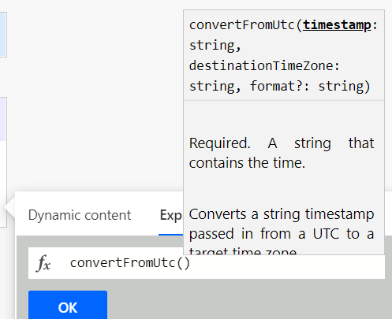
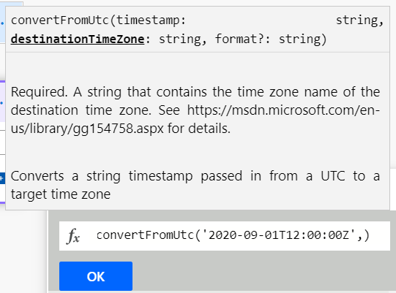
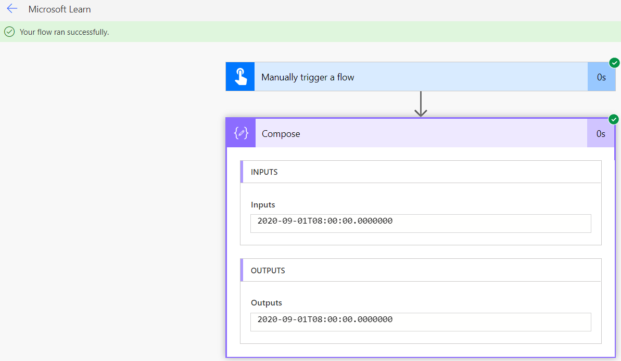
Auto suggest, hints, and links in the formula bar
Notes:
When you enter a function in the formula bar, you will see a pop-up with syntax suggestions.
Here you can see for the convertFromUtc function that it has two required inputs and one optional input. Timestamp is required and expects a string, destinationTimeZone is required and expects a string, and format? is optional and expects a string. Note the "?" at the end of format. That tells you it is an optional input.
After entering a Timestamp as a string typing a comma, then prompts for the destinationTimeZone:
This can be daunting. What does it want for the time zone? If you look in the pop-up, you'll see that it provides a link to the list of time zone values. This page provides you the string for the destinationTimeZone. With that information, we can now complete the expression.
convertFromUtc('2020-09-01T12:00:00Z','Eastern Standard Time')
With the complete formula, you can select OK to save your changes. Always be sure to select OK or UPDATE when editing an expression. If you select out of the inputs, you will lose your changes. Flow does not have autosave.
With your first expression complete, you can now select Test in the top right-hand corner. Then select Save & Test. select the Run flow button and then Done.
You should see the green bar that says "Your flow ran successfully." Expand the Compose action and you will see that the OUTPUTS is your date time converted to the new time zone.
Use this same process to see the output of any test expressions you create.

Slide 74
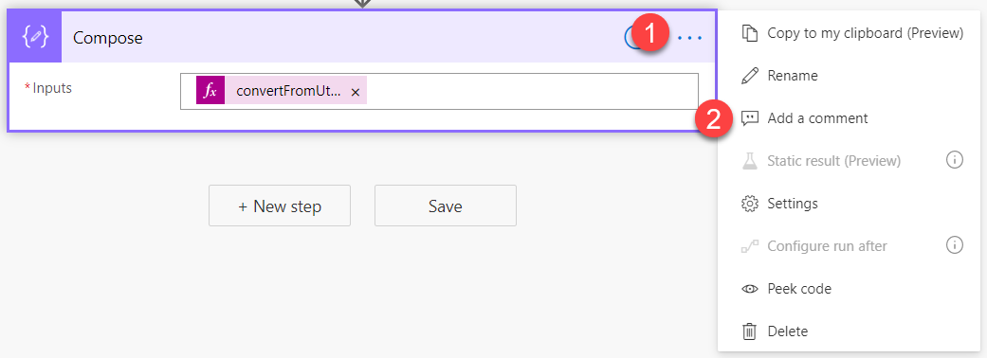
Comments make things easier
When you look at the convertToUtc expression you wrote earlier, you might notice that you need to scroll to see the whole formula in the function bar.
Notes:
When you look at the convertToUtc expression you wrote earlier, you might notice that you need to scroll to see the whole formula in the function bar. A common technique to make reviewing your expression easier is to use Comments and pasting the whole formula into the comment.
[!div class="mx-imgBorder"] paste the formula into the comment
To add a comment, select the ellipse to show the menu. Then select "Add a comment".
[!div class="mx-imgBorder"] select the ellipsis and "add a comment"
Then you can enter any text you want. This could either be text or just a copy and paste of your expression as shown previously.

Slide 75
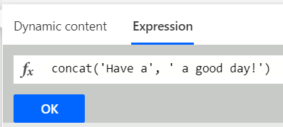
Defining text
When you use text in a flow expression, you will use the ' (single quote) at the beginning and end of each string.
Code
Concat('Have a', ' good day!')
Notes:
When you use text in a flow expression, you will use the ' (single quote) at the beginning and end of each string. For example, if you wanted to combine the string "Have a" and "good day!" in an expression, you would use the Concat function and your syntax would be:
Concat('Have a', ' good day!')
[!div class="mx-imgBorder"] concat function syntax
These little details will help you more effectively work with expressions. One of the great things about expressions is that they are consistent and as you learn about one function you can often apply those learnings to the next function, rapidly speeding up your learning.

Slide 76
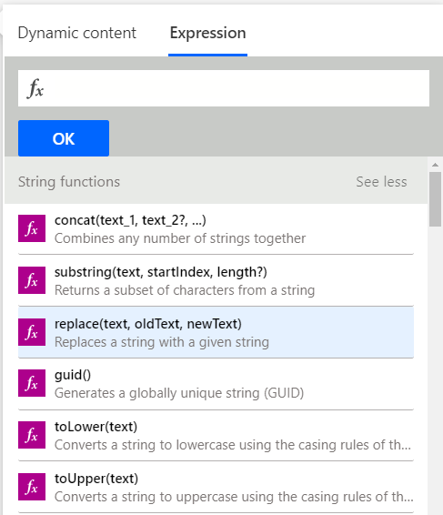
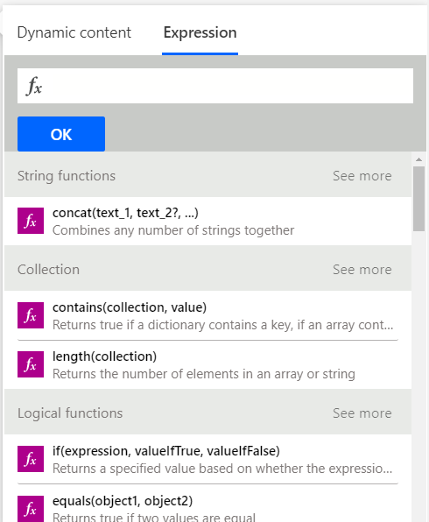
Types of functions
Functions are grouped into 10 different categories like math and logic.
Notes:
Functions are grouped into 10 different categories like math and logic. The categories are just a logical organization to making finding the function you need easier. Below you will get an overview of each category and some examples.
Keep in mind as you go through the various examples, we use static text and values. This is to allow you to test and recreate the examples as easily as possible. In your flows, you may substitute dynamic content in place of this static data. Just ensure that your dynamic data is the correct format for the function.
In the screenshot below, you will notice to the right of each category header (like String functions or Collection) the words "See more." By selecting "See more," the complete list of functions for that category will be shown.
[!div class="mx-imgBorder"] See more for complete list of functions
Select See more beside String functions.
[!div class="mx-imgBorder"] String functions see more

Slide 77
String functions
String (text) functions are used to modify strings, find characters in a string, format strings, and more.
Power Apps Formula
formatNumber(12.5,'C’)
formatNumber(12.5,'C','ja-JP')
Notes:
String (text) functions are used to modify strings, find characters in a string, format strings, and more. Text manipulation is a core skill often used when trying to better format or modify data you received from somewhere else.
An example of a string function is the formatNumber function. This function can convert a number into a string in a given format. A common request is to make a string look like currency. To change the number 12.5 into $12.50, use the following formula:
formatNumber(12.5,'C')
The C represents the Currency numeric format string. Don't worry, a list of the other options are available at Standard numeric format strings. You also might be asking what if you wanted to show the number as currency but with the Yen symbol? There is an optional parameter where you can pass the locale.
formatNumber(12.5,'C','ja-JP')
This formula will return ?13.

Slide 78
Collection functions
These functions are used for arrays and strings.
Code
length('I love Power Automate.')
Notes:
These functions are used for arrays and strings. They may be used to check if an array is empty, to grab the first, or last item, or even for join, union, and intersection operations.
An example of a helpful Collection function is length. You can use length to return the number of items in a string or array. The following example would be used to count the number of characters in the string "I love Power Automate."
length('I love Power Automate.')
The output would be 22. You can use this type of function for validation or in conjunction with the String functions to manipulate strings.

Slide 79
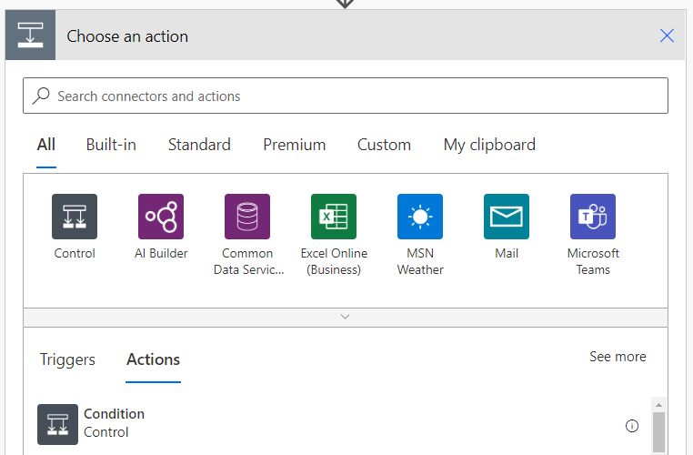
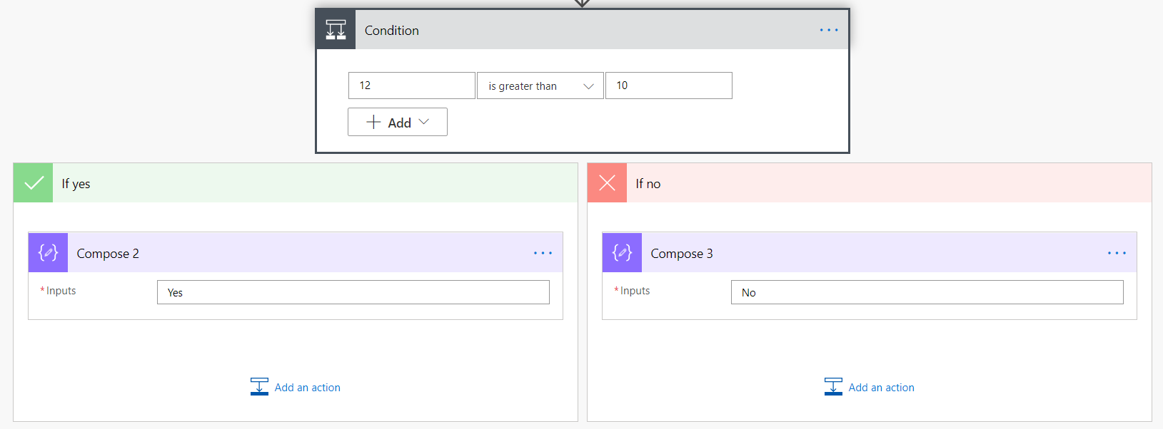
Logical functions
These functions are used to work with conditions, to compare values, and to do other logic-based evaluations.
Code
If(greater(12,10),'Yes','No')
Notes:
These functions are used to work with conditions, to compare values, and to do other logic-based evaluations. These are often thought of as If statements where you want to compare if a number is greater than another number. Flow supports all of the logical comparisons you would expect.
In the example below, an expression will compare if 12 is greater than 10 and then output the appropriate string. This will also be your first expression that uses more than one function. We will combine if and greater logical functions.
If(greater(12,10),'Yes','No')
The result of this expression would be the string "Yes". To understand the expression, work from the inside out. Greater(12,10) returns true or false depending on if 12 is greater than 10. Since it is, the value returned is true.
Now that you know the answer is true, you can see that the If function returns the data after the first comma. In this case that is the string "Yes". Had it been false then the string "No" would have been returned.
[!IMPORTANT] While you can write logical expressions as shown above, there is also an action called Condition that lets you write If statements without an expression.
[!div class="mx-imgBorder"] condition to write if statements without an expression
Here is the same condition written using the action.
[!div class="mx-imgBorder"] condition written using the action
You will find over time that you use a combination of both methods depending on your requirements.

Slide 80
Conversion functions
Power Apps Formula
These functions are used to change the type of your data.
Power Apps Formula
Int('12’)
Float('12.4’)
If(greater(Int('12'), Float('12.4')),'Yes','No')
Notes:
These functions are used to change the type of your data. This can be simple things like converting a text number into an integer, or more complex functions like changing the encoding of a file from base64 to binary. Knowing that these functions are available will help you overcome problems you encounter when getting your data shaped correctly.
A common scenario is the need to use int or float to change a text number into an actual number. This is common when importing data into your flow from a data source. The number 12 or 12.4 may be stored as text. In order to use that number in a logical function or write it to a location that expects a number, you will need to covert it. The following example changes the string "12" into the integer 12.
Int('12')
That will output the integer 12. Had it been the string "12.4" then you would need to convert it to a float because of the decimal digits. In that case you would use
Float('12.4')
Now you could use text number to do the previous example.
If(greater(Int('12'), Float('12.4')),'Yes','No')
This would output the string "No" because 12 is not greater than 12.4. Combining functions like this is common and is a useful pattern to learn.

Slide 81
Math functions
Math functions do exactly as you would expect.
Power Apps Formula
Add(12, 13)
add(add(12,13),15)
Notes:
Math functions do exactly as you would expect. They allow you to add, subtract, multiply, and perform other similar functions. In addition, Math functions allow you to find the smallest and largest numbers of several numbers or get a random number, amongst other things.
One thing to keep in mind is that there is a different function for adding numbers (add) and for subtracting numbers (sub). Many formula languages add negative numbers to produce subtraction, but flow does not. To add two numbers together, you use the following:
Add(12, 13)
This would return 25. If you wanted to add three numbers, then you would need to add a second function like so:
add(add(12,13),15)
This would return 40. As you have seen before, you will often find yourself nesting functions to get your desired results.

Slide 82
Date and time functions
These functions are used to return the current date and time, change time zones, find specific info about a date and time, and do other date/time manipulations.
Code
convertFromUtc(utcNow(), 'Eastern Standard Time', 'dd-MM-yyyy hh:mm tt' )
Notes:
These functions are used to return the current date and time, change time zones, find specific info about a date and time, and do other date/time manipulations. If you have date and time values in your data, you'll need these functions.
One important thing to remember as you explore date and time functions in flow is that they are often based on UTC. Most data sources pass data back and forth with flow in UTC format. Also, if you use the function UTCNow() that will return the current time in UTC format. If you want to use that to compare to user data that is currently in the Eastern Time Zone, then you will need to use the following formula to convert it:
convertFromUtc(utcNow(), 'Eastern Standard Time', 'dd-MM-yyyy hh:mm tt' )
This will output 01-09-2020 05:39 PM. For a complete list of the date time format options, review Custom date and time format strings.

Slide 83
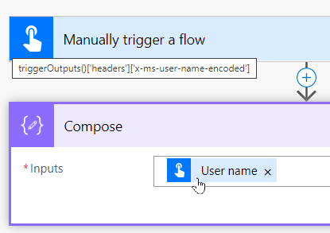
Referencing functions
The referencing functions are used to work with the outputs of your actions and triggers.
Code
triggerOutputs()['headers']['x-ms-user-name-encoded']
Notes:
The referencing functions are used to work with the outputs of your actions and triggers. The nice thing is that the majority of the time, flow will write these functions for you. When you add dynamic content to your flow, you are using referencing functions without knowing it. If you add dynamic content and then hover of that content, you can see this in action.
In the screenshot below, by adding the User name dynamic content from my trigger to the Inputs for Compose you can see this in action.
[!div class="mx-imgBorder"] add user name dynamic content from trigger
By hovering over User name with the mouse pointer, you can see
triggerOutputs()['headers']['x-ms-user-name-encoded']
Flow created the expression using the triggerOutputs for you. It is the pulling from the Headers property the x-ms-user-name-encoded property. Most of the time in flow you will reference these properties via dynamic content. But it is possible to write your own expressions to recreate this if necessary. Each trigger and action will have different formats for how you retrieve their data.
Explore these functions by adding different triggers, actions, data sources, and apply-to-each loops in your flow. Then, use their properties as dynamic data to see more examples. The good news is writing these types of expressions is not common.

Slide 84
Workflow functions
The workflow functions are used to retrieve information about your flow and are closely related to the referencing functions.
Code
Workflow().run.id
Notes:
The workflow functions are used to retrieve information about your flow and are closely related to the referencing functions. One of the functions is called workflow. You can use it as shown below.
Workflow().run.id
This will return the ID of the current flow run. You could use this for error reporting or logging if needed. These functions are not commonly used.

Slide 85
URI parsing functions
These functions are used to dissect a URI that is passed in as a string.
Code
uriQuery('https://flow.microsoft.com/fakeurl?Test=Yes')
Notes:
These functions are used to dissect a URI that is passed in as a string. You may use these functions to find the host, path, query string or other portions of the URI. The following example shows you how to use uriQuery to get the query string portion of the given URI.
uriQuery('https://flow.microsoft.com/fakeurl?Test=Yes')
This would return the string "?Test=Yes" which you could then parse with string functions to get the value passed in from the URI.

Slide 86
Manipulation functions
Manipulation functions are used to work with specific objects in your flow.
Code
Coalesce(null, 'Power Automate', 'Power Apps')
Notes:
Manipulation functions are used to work with specific objects in your flow. You can do things such as find the first non-blank value, work with properties, or find xpath matches. These functions are used typically in JSON or XML nodes evaluations.
One function you may find handy here is coalesce. This function will allow you to find the first non-null value from a specified set of values. You use the function as shown in the following formula:
Coalesce(null, 'Power Automate', 'Power Apps')
This formula would return the string "Power Automate". Handy when you are passing in multiple values and want to find the first one that is not null.

Slide 87
Exercise: Creating a manual flow and using expressions
Follow the exercise in the student manual

